Slide 1
Let’s get the party started!

Slide 2
Intro
The music and event industry in the 21st century still mostly functions analogously, especially when we talk about the B2B method.
As someone who has been actively involved in IT for many years and several years of organizing events, we have seen many shortcomings in logistics, speed, accessibility and data mining, which applications can solve much faster and easier, and because there is a great demand for such services on a global scale, we came up with the idea to offer a digital solution to the problems that artists and event organizers face in real life.

Slide 3
Problem
You are organizing an event, but... How to quickly and easily find a quality DJ, musician, music band, entertainer, venue or place for your event or service related to music or event organization, but you don’t know WHERE to go and WHO to look for?
Maybe you have a vision of what your event should look like, who you’re looking for, and what genre you’re looking for, but you don’t know the exact name of the DJ, musician, music band, entertainer, or service you’re looking for? Why would you even need to know the NAME?

Slide 4
A small task for you
If you first thought of social media or Google as a solution where you could find a DJ or music band for your event, here’s a little task for you!
Find rock bands or DJs who play house music from the USA that are free for booking from 1st Dec to 31st Dec and without having to contact them and ask when they are free for booking. It would also be advisable to have positively rated reviews between 80 and 100% because of course, you want to hire only professionals for your project.
It’s not so easy? Why?

Slide 5
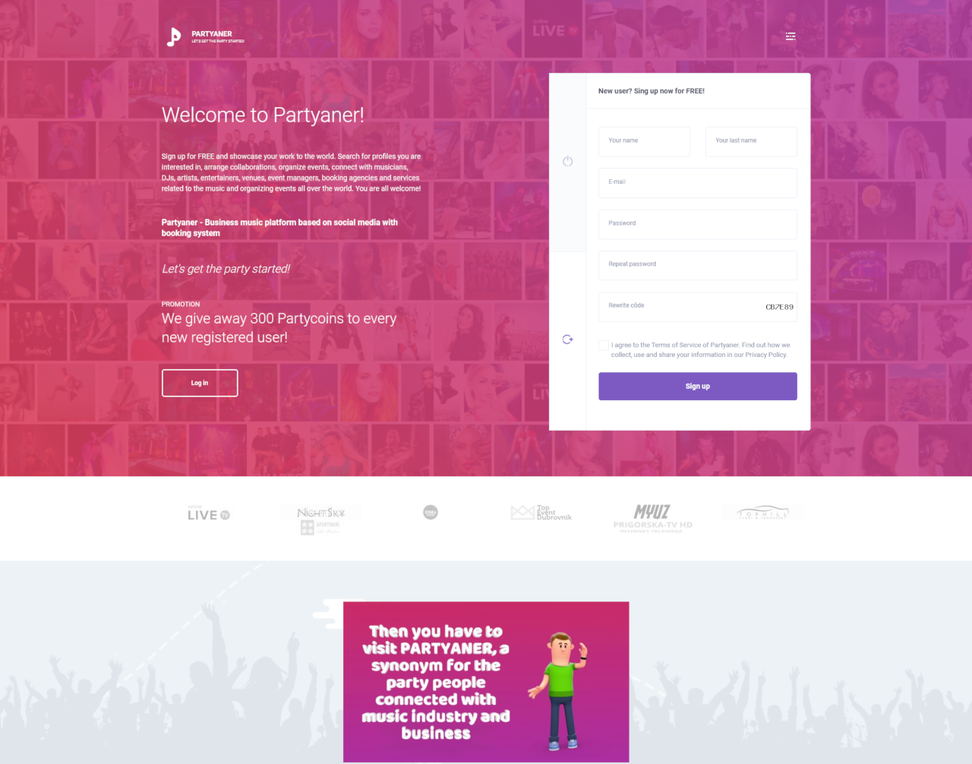
What is the Partyaner?
Partyaner is an event booking platform (B2B SaaS) based on social media, specializing in connecting common interests in the music business, event management, entertainment, art, culture, catering, tourism and promotion, but even more than that.

Slide 6
Solution!
Partyaner solves many expensive types of problems. Music is an universal language all over the world, so the project is global.
Partyaner is actually a digital catalog, a combination of a booking site and a social network in one with the aim of connecting common interests and our main feature is an advanced profile search.
Our slogan is: "Let's get the party started!"

Slide 7
Mission and Vision
We want to create a centralized place for all musicians, artists, venue owners, event managers, booking agencies and services related to music to connect with each other in order to arrange their collaborations, but also a centralized place for their promotion and market research for event organizers based on collected data.
We want all Partyaner users to use our platform for as long as they want to generate income, and we think that’s forever!
Who doesn’t want to earn more than they currently earn? We are all here for common interests!

Slide 8
Who can sign up on Partyaner?
Musicians, DJs, music bands, artists, dancers, choreographers, dance groups, entertainers, clubs, discotheques, wedding halls, cafe bars, hotels, restaurants, accommodations, managers, booking agencies, record/label companies, hostesses, waiters, bartenders, photographers, cameramen, producers, painters, sculptors, graffiti artists, cartoonists and all services related to music, culture, tourism, catering and event organization.
EVERYONE CAN, YOU CAN TOO!

Slide 9
Partyaner profile types
Musician / Artist
Music band / Group
Manager / Agency
Venue
Entertainer
Service
Difference between account and profile? We will explain this later.
Each user can create an unlimited number of profiles, but the creation of the first profile is free!

Slide 10
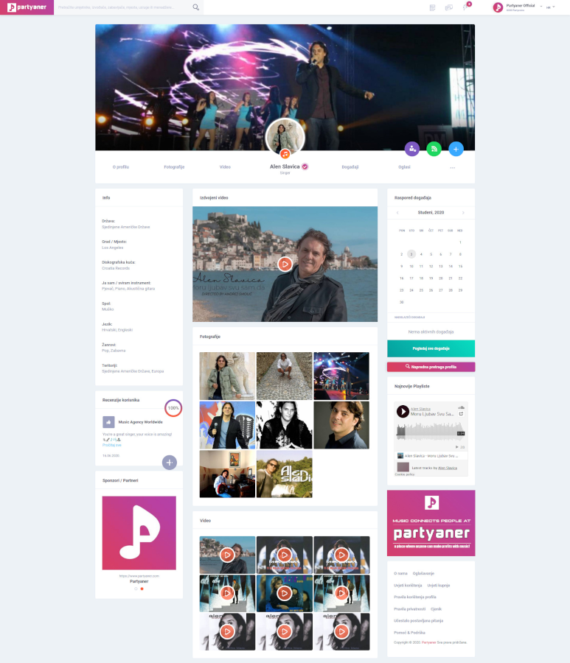
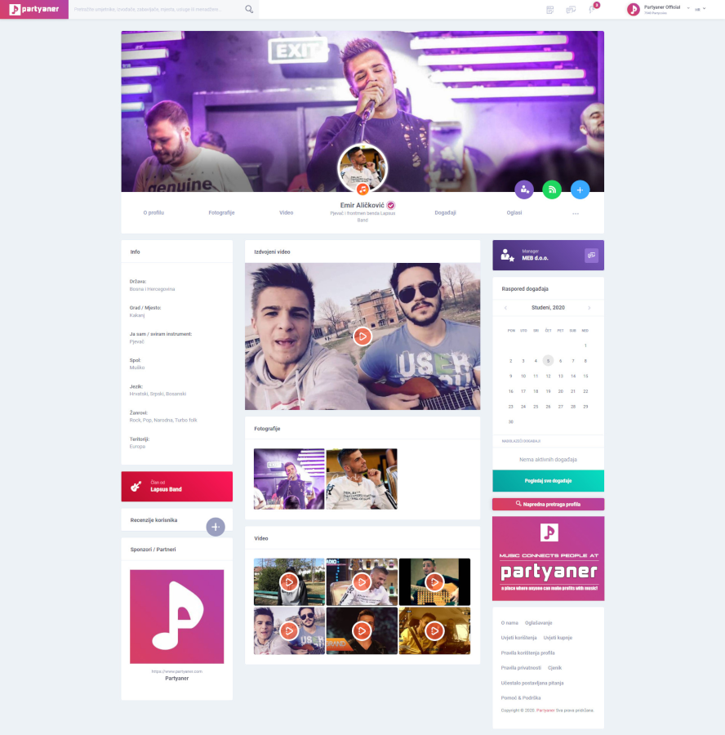
Profile „Musician”

Slide 11
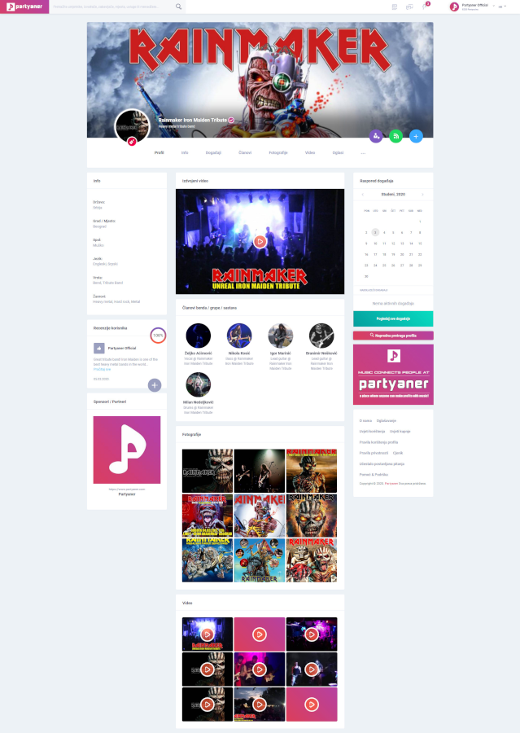
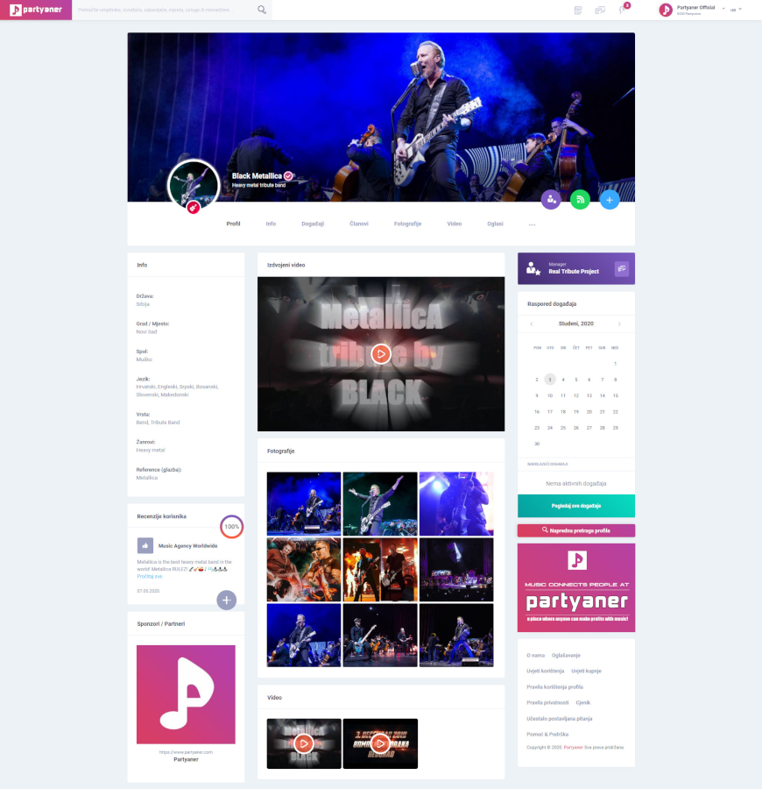
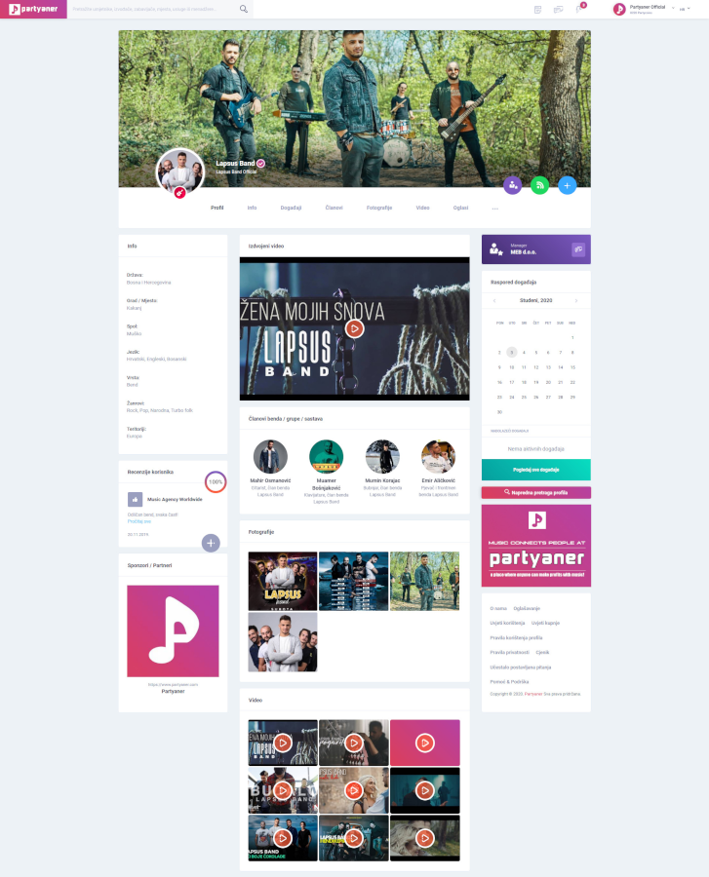
Profile „Music Band / Group”

Slide 12
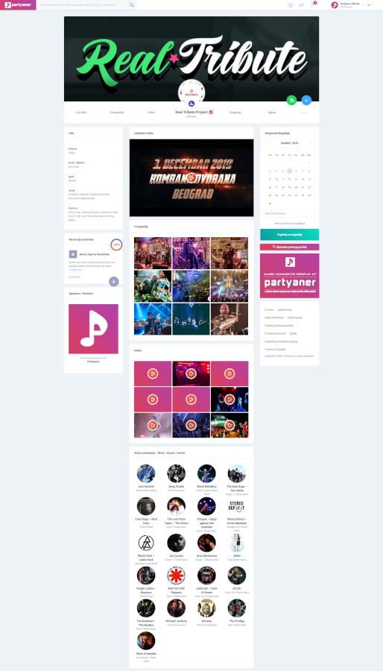
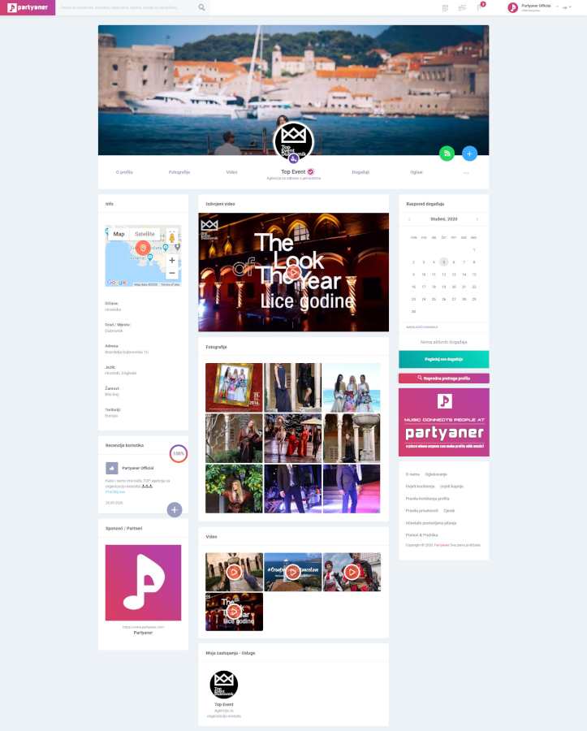
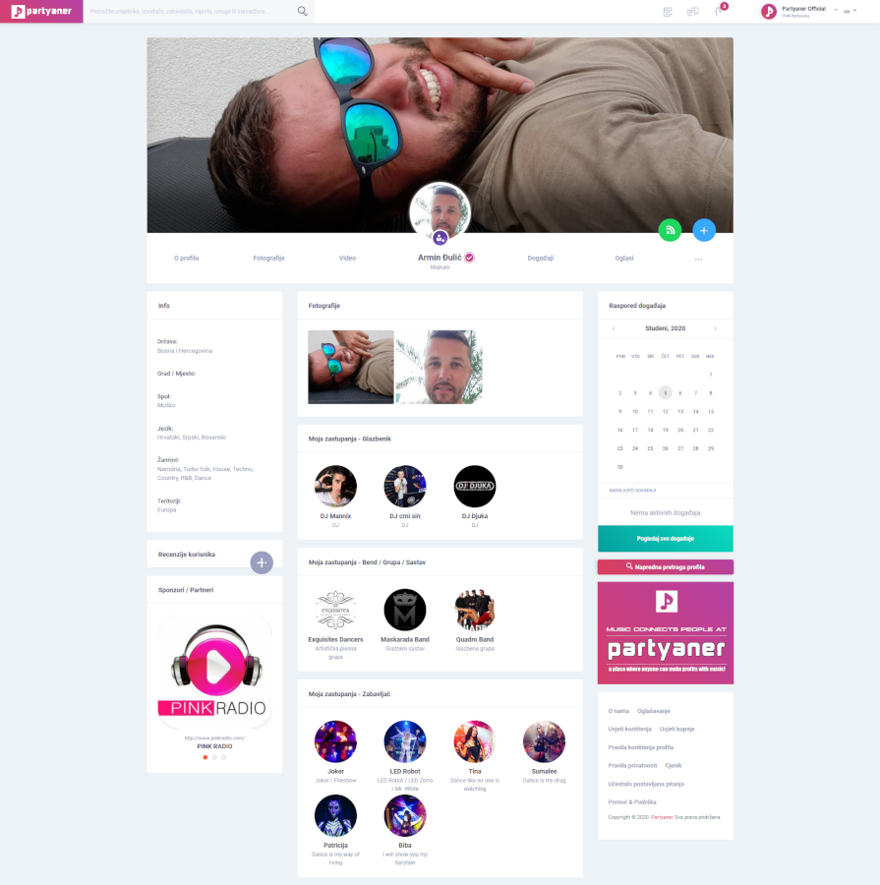
Profile „Manager / Agency”

Slide 13
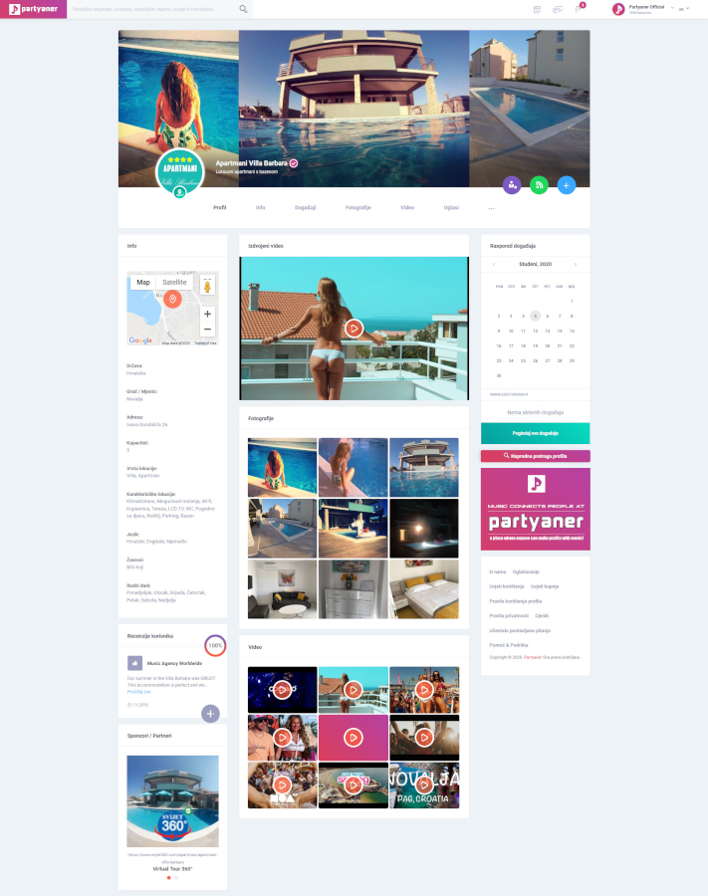
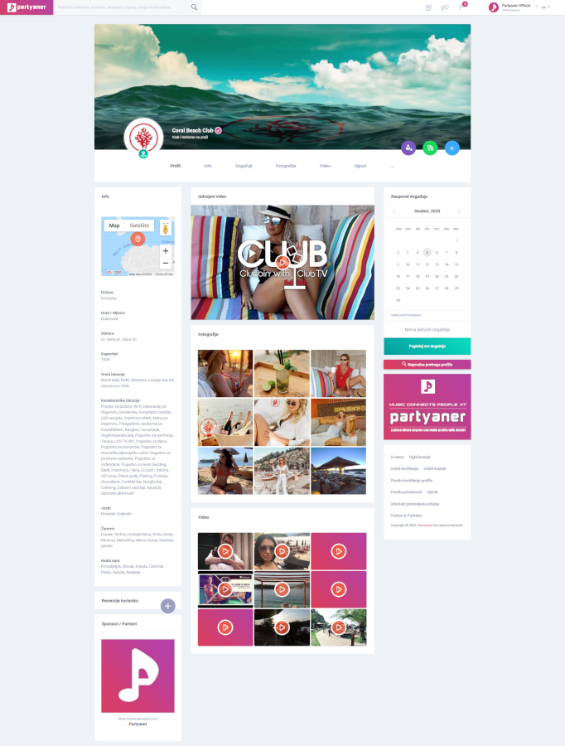
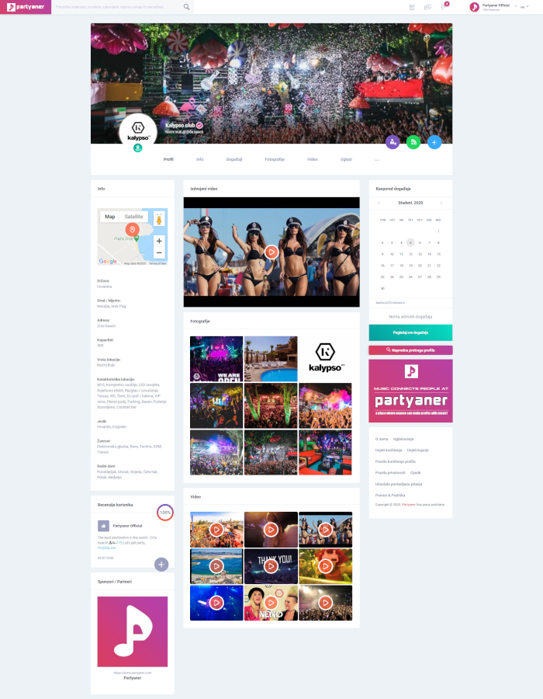
Profile „Venue”

Slide 14
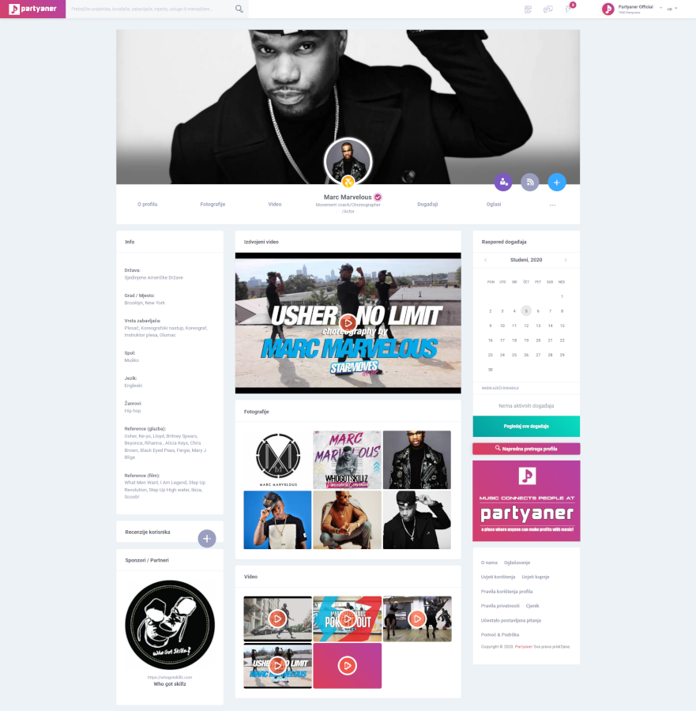
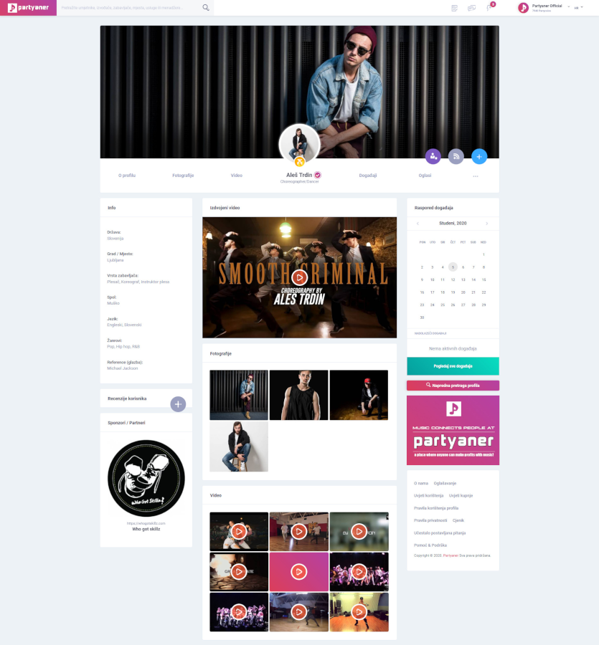
Profile „Entertainer”

Slide 15
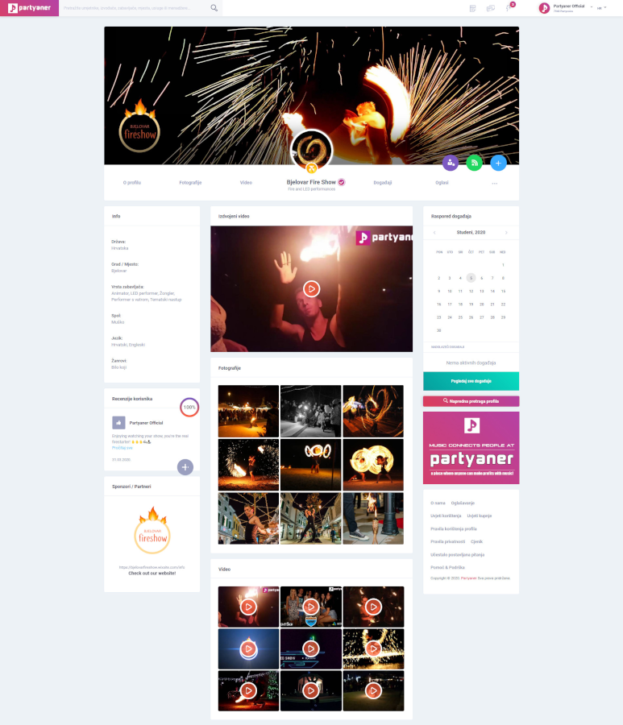
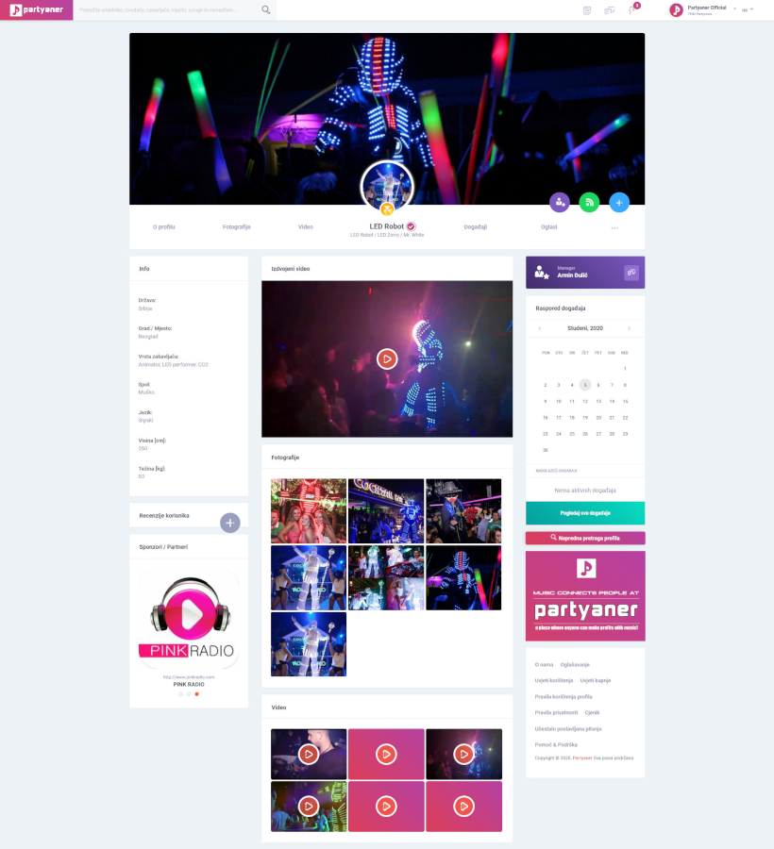
Profile „Entertainer”

Slide 16
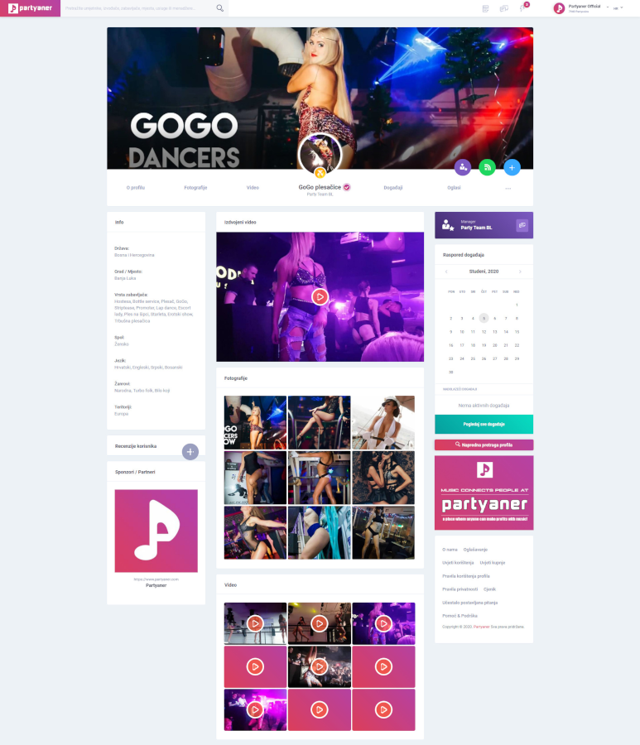
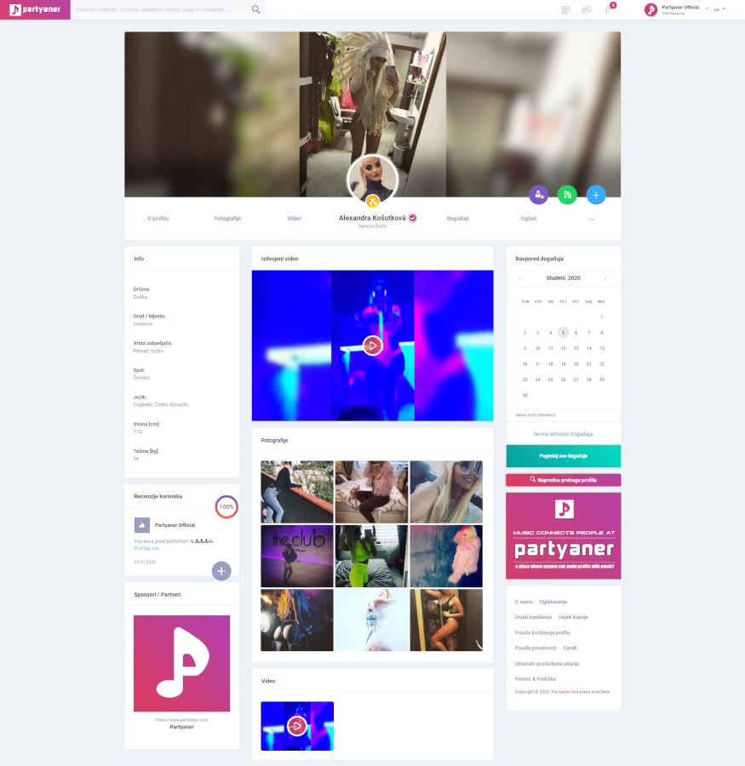
Profile „Entertainer”

Slide 17
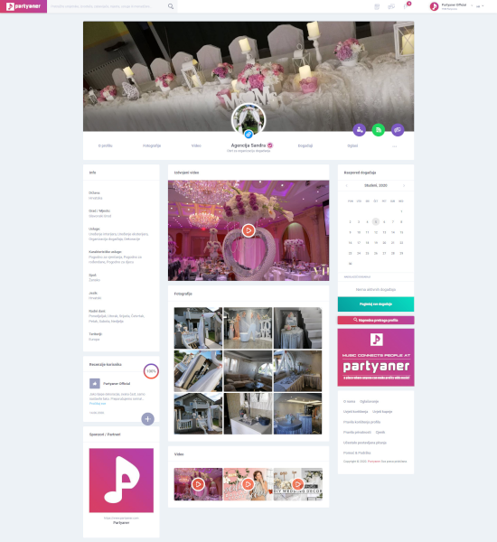
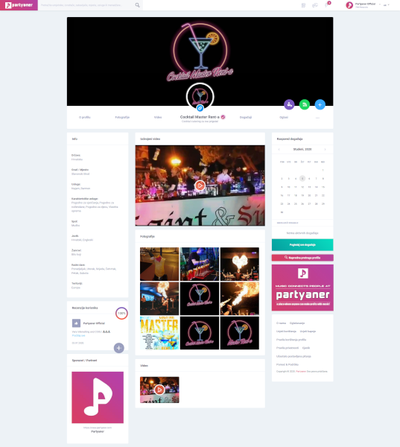
Profile „Service”

Slide 18
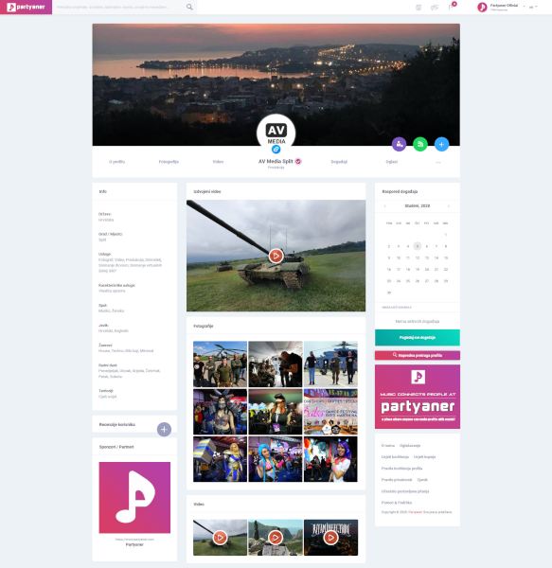
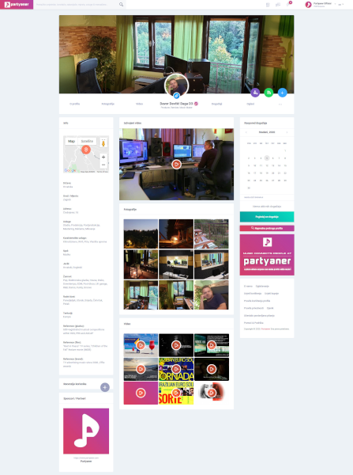
Profile „Service”

Slide 19
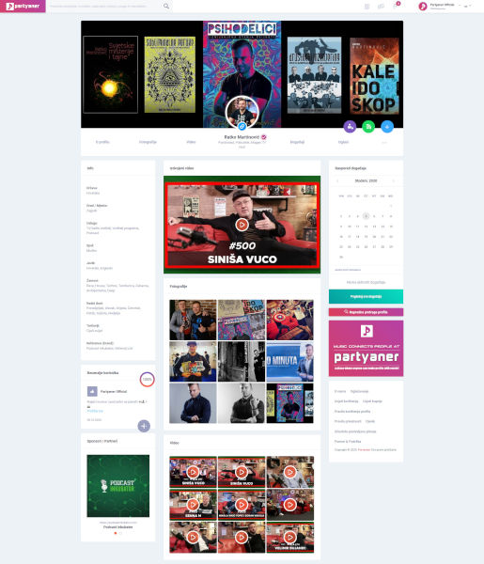
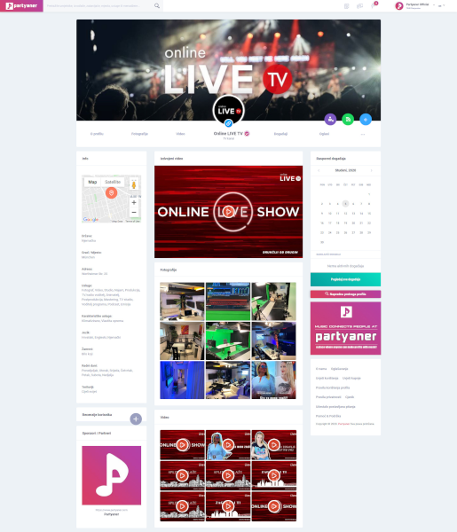
Profile „Service”

Slide 20
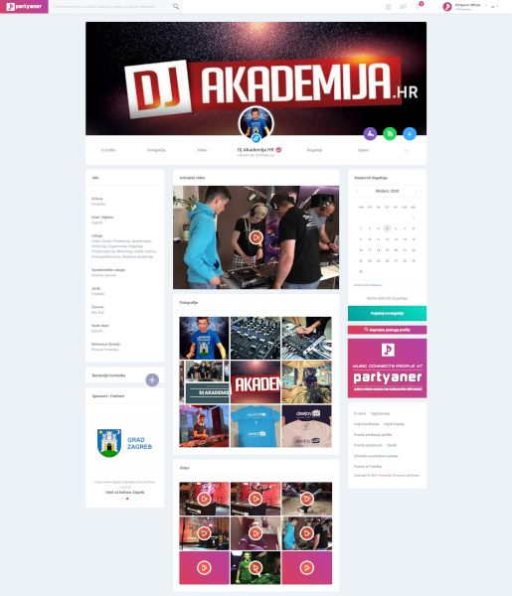
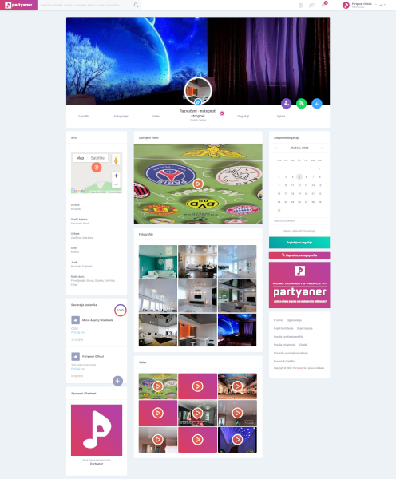
Profile „Service”

Slide 21
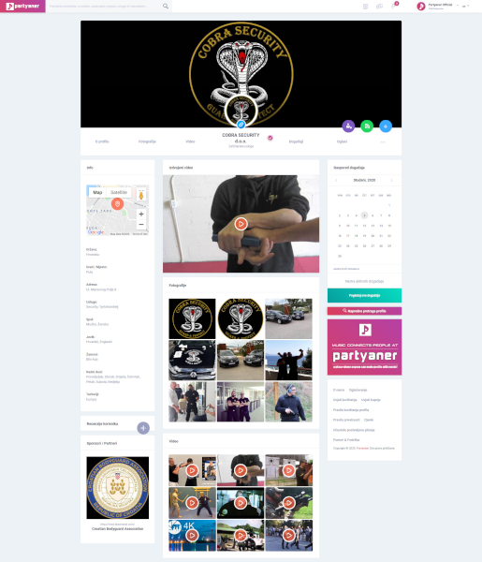
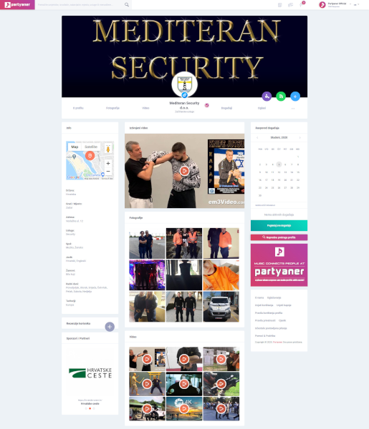
Profile „Service”

Slide 22
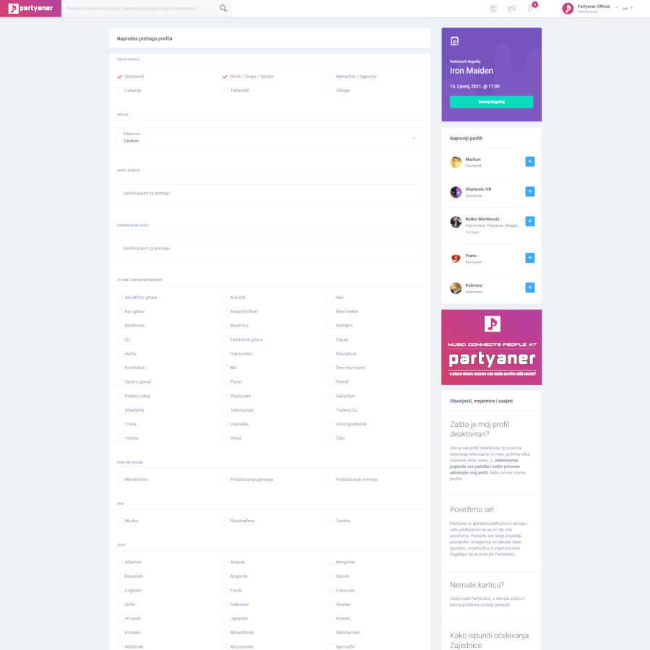
Advanced profile search
Unlike classic social networks, on Partyaner it doesn't really matter who is who on the network, but what does a person actually do and what’s their rating, and this is where the advanced profile search steps in, through which it is possible to find exactly those profiles/services that interest our users and that is the best Partyaner’s feature!

Slide 23
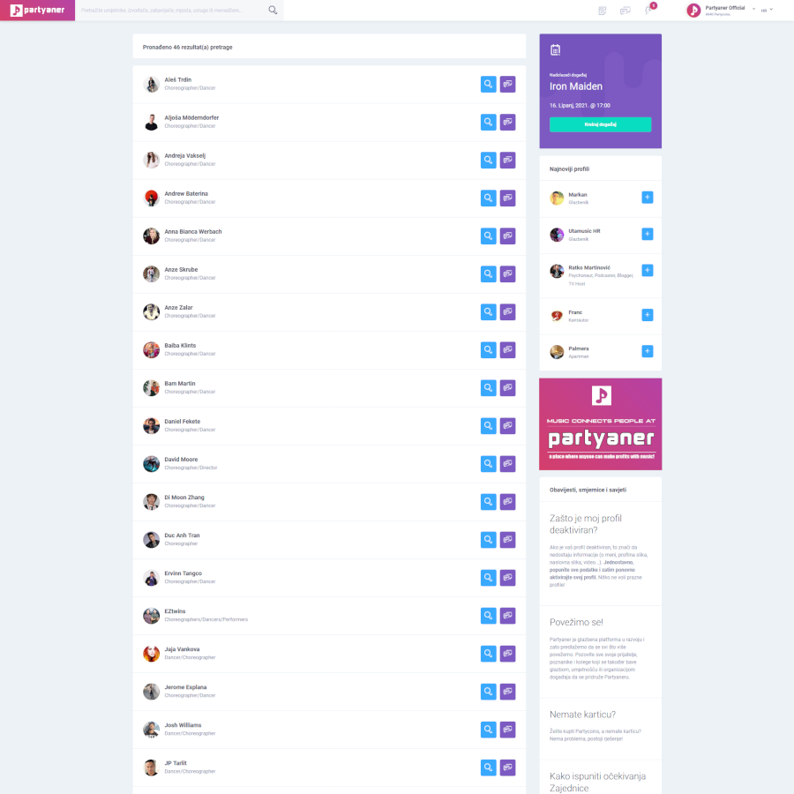
Search results
By selecting specific filters, specific profiles are displayed in the search results that can be contacted immediately.
Club owners and event managers can quickly and easily find exactly those profiles that interest them without having to know what their name is and when they’re free for booking.

Slide 24
Is it free?
Many services on the Partyaner are free, however some features as well as access to and use of some parts of the platform are limited. In other words, only professional services are paid which generates profits.
Registration is free and use of the site is without any obligations!
There are no monthly or annual subscriptions, everything is used on demand.

Slide 25
Is it free?
We wanted to meet the needs of our customers to the maximum, so that most services are free, and those that are paid have symbolic amounts so the platform is tailored to everyone’s budget.
We want every Partyaner user to always get more than they invest, and that is really possible on Partyaner!
Registration
Account setup
Creating the first profile
Filling in the profile
Filling the calendar occupancy
Quick and advanced profile search
View all profiles
Writing reviews
Creating the events

Slide 26
WIN-WIN-WIN situation!
Partyaner is one of the few companies in the world (perhaps the only one) where no one is at a loss because the business model is designed so that everyone is always at a profit!
Example:
The club owner or manager is organizing a concert and needs a music band. After the concert, the club owner made money from drinks sold and tickets sold, the music band earned a fee for that gig, and the Partyaner made money from both sides. Who is at a loss then? Conditionally speaking only the guests are at a loss, but they are not at a loss either because they actually paid for the party!

Slide 27
What does a Partyaner user get by registering?
When registering, we give away 300 Partycoins to each new registered user, with which they can immediately start using and paying the professional services of Partyaner.
After the user spends 300 PCs, makes sure that the whole system works and that he generated income thanks to Partyaner, he can buy additional Partycoins so that he can continue to use professional services, arrange collaborations and generate even more income.
It is in the interest of Partyaner that all its users always earn more!

Slide 28
How does it looks like in reality?
Getting in touch costs 20 PCs, which is the equivalent of about €2. By registering, the user gets 300 PCs (approx. €30), which means that he can arrange 15 collaborations, i.e. performances. Symbolically, if in these 15 performances the Partyaner user earns at least €1, that user is in the plus of €1. Of course, in reality, the budgets for performances are far higher. That way it is impossible to go into the red on Partyaner!
Partyaner is based on the philosophy: "First help others to help yourself" and „Join pleasant with useful forever".

Slide 29
Partycoins
Partycoins (PC) is a virtual currency used to pay for professional services on the Partyaner and was implemented to make them easier to use, so that users would not have to enter their credit card details for each payment.
Partycoins can be purchased only by registered Partyaner users by selecting the desired amount of Partycoins, after which the user is directed to the online card payment system.

Slide 30
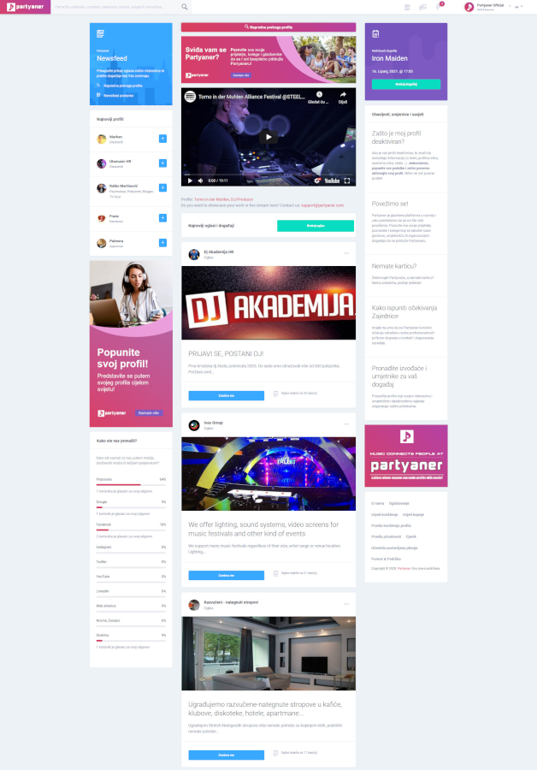
Newsfeed
After successfully registering and logging in to the website, Newsfeed opens where are events and Ads are shown.
When a user is interested in an Ad, he can simply click on the "I'm interested" button.

Slide 31
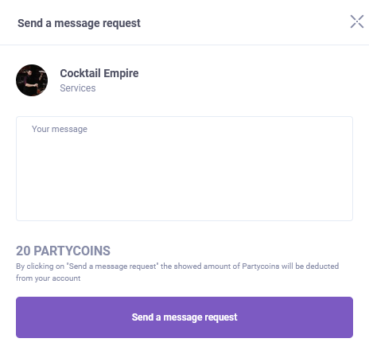
Booking
The booking system on the Partyaner works on the principle of establishing contact in order to agree on some form of cooperation.
Cooperation types:
Profile management
Membership in a music band / group
Send a message request
Ad response

Slide 32
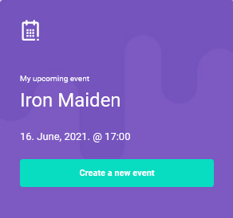
Events
Events on the Partyaner serve so that users can keep track of where and when festivals, concerts, parties, fairs, plays, weddings, birthdays, etc. are held, but also for promotioin.
Partyaner can also serve as an event planner, especially if you have, i.e. run multiple profiles, because Newsfeed always shows you your upcoming event.

Slide 33
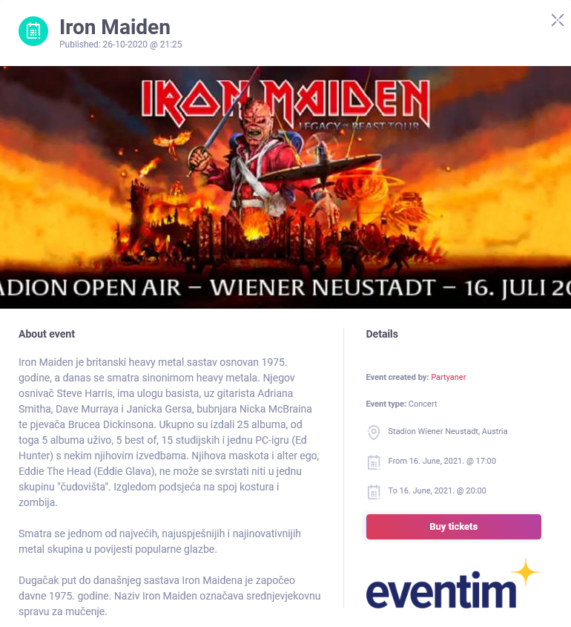
Events
Each event consists of a description of the event, who created it, what type of event is, where it takes place, the date and time when it starts and ends and if there is a link to online ticket sales then the "Buy tickets" button is displayed which leads to a website where tickets can be purchased online.

Slide 34
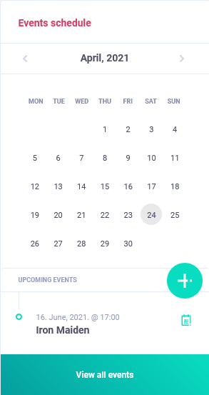
Events schedule calendar
Each profile has its own occupancy calendar where it is possible to see exactly when someone is free or not for booking.
There are public and private events that can be seen on that calendar.

Slide 35
Advertising
Ads on the Partyaner are used to advertise users in terms of supply and demand for products or services. So, Partyaner users can create their own Ads if they offer or ask for something related to music, art, collaboration or event organization.
When creating an Ad, you need to choose the duration of the Ad of 7, 15 or 30 days. Of course, the longer the Ad lasts, the higher is the cost of advertising.

Slide 36
Advertising
Each Ad can be targeted to certain types of profiles. Also, each Ad can contain Ad details.

Slide 37
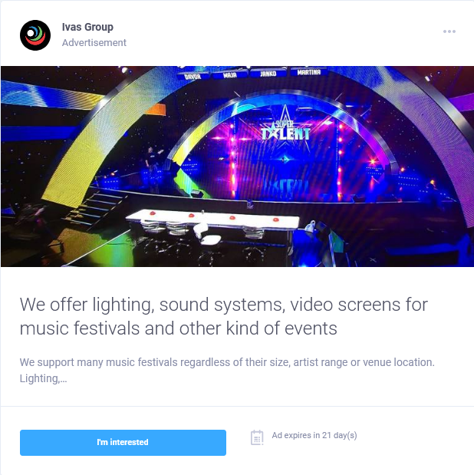
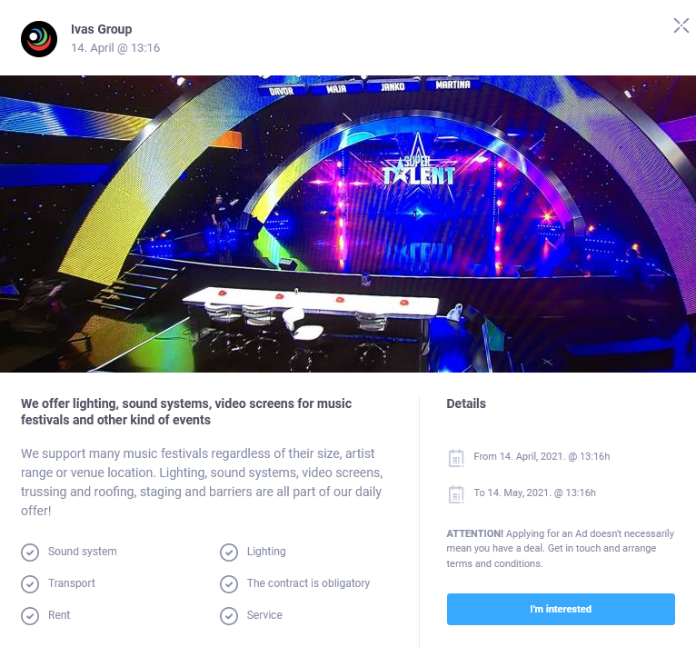
Advertising

Slide 38
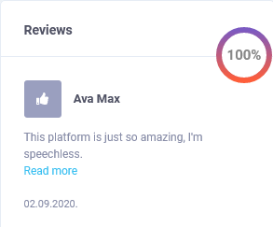
Reviews
Reviews on Partyaner are resolved better than on any other booking page - we only count the trend of the recent year!
This means that if a profile was rated negatively more than a year ago, that rating no longer counts as a total percentage.
The reason for this is that some performers/artists have been able to progress over time so it doesn’t matter what they were like more than a year ago because realistically people are interested in what the trend is today, i.e. the recent year.
The overall rating is expressed as a percentage of positive reviews.

Slide 39
Managing
If you are a manager or you have a booking agency then you can offer your managing services to any Partyaner profile you want to represent.
The owner of the profile to which you are sending the request for managing can decide whether he wants to accept or reject your request. In case he accepts your request then you become the manager of that profile and all further inquiries through that profile will be sent to you!
You can manage an unlimited number of profiles, and all inquiries for the profiles you manage will always reach you and that is why there is no bypassing managers and agencies on Partyaner, as is the case on other social networks!

Slide 40
Managing
What you, as an agency/manager, can do for your part is to make it a condition for everyone to be on the Partyaner if they want to cooperate.
Also, one profile can be managed by multiple managers/agencies. In this case, the organizer can choose the manager with whom he wants to establish contact and cooperation.
If someone is looking for a manager, Partyaner is the right place for him/her!

Slide 41
Membership in a music band or group
As a musician or entertainer, you can submit a membership request to join a music band or group.
The owner of the profile to which you are sending the membership request can decide whether they want to accept or reject your request. In case he accepts your request then you become a member of that music band or group!

Slide 42
No spamming!
There is no spamming on the Partyaner because each user can decide in advance whether they want to accept or reject the message request.
Only after one user accepts the message request of another user then they get in touch and start a conversation.

Slide 43
Reporting on Partyaner - Protection
In order to protect users on the Partner, any user can report inappropriate content.
List of elements the user can report:
Profile
Event
Ad
Photo
Video
Users can report:
Violence or violent behavior
Spam or scam
Hate speech or personal attack
Sexually explicit content
Another reason

Slide 44
Potential
Partyaner is a global project because the services offered by this platform are sought after and applicable worldwide. Partyaner is currently in English and Croatian, and over time it will be translated into all other world languages.
Partyaner LLC is registered in the city of Novalja on the island of Pag due to the proximity of the world famous tourist destination Zrće beach.
This type of business platform, which is a combination of a social network and a booking site and which specializes in music, art, entertainment industry, event organization, culture, tourism and promotion, does not exist anywhere in the world and is therefore unique!

Slide 45
Potential
There are already registered users from all over the world!
The idea originated and developed on listening to the needs of people involved in music, art, event organization, culture, catering, tourism and promotion, because digitalization is the best solution for rapid exchange of information when it comes to such jobs with an emphasis on global interconnection. Users thus have everything at their fingertips and they don’t have to have bunch of phone numbers in their cell phones.
The main feature of the Partyaner is an advanced profile search which changes the perception of the business in the sense that it is not so much important who is who on the network, but it’s more important what does a person actually do and what reviews he/she has! This service is free for all Partyaner users!

Slide 46
Potential
Partyaner has a great potential to develop into a platform with more and more services that can be profitable, both for users and for Partyaner itself. It is very important to always listen carefully to the needs of the market and follow trends and be able to adapt to these needs and make decisions for further development based on that.
If Partyaner manages to solve some real life situation for you and if you are willing to pay for it, then we have all succeeded together!

Slide 47
Potential
The best part of this platform is the collection of users' meta data, on the basis of which event organizers will be able to plan their events more precisely, especially if we are talking about financial risks, which can be minimized this way, and Partyaner users will be able to more easily find clubs where they want to party, according to their interests and budgets.
That's why Partyaner is far more than just a booking platform!

Slide 48
Conclusion
We at Partyaner no longer want to listen to “we can’t find” statements when someone wants to organize an event! Everything you need to organize any type of an event you have on the Partyaner, no matter if it is a small or large event.
Partyaner is not a classic "offer / demand" classified Ads, but a sophisticated platform specializing in music, art and event organization!
Partyaner is a platform that is accessible to everyone, registration is free, and it is tailored to everyone's budget because the prices of professional services are truly symbolic.

Slide 49
Conclusion
The basic idea is that Partyaner offers its customers a business opportunity so that by contacting and arranging cooperation, customers really always earn more than they invest and use it as long as they want to generate income, and we believe that it’s forever!
That’s why this project is profitable for everyone in the long run and everyone have benefits of it!
Let’s get the party started!

Slide 50
THANK YOU FOR YOUR ATTENTION!

